Slide 1
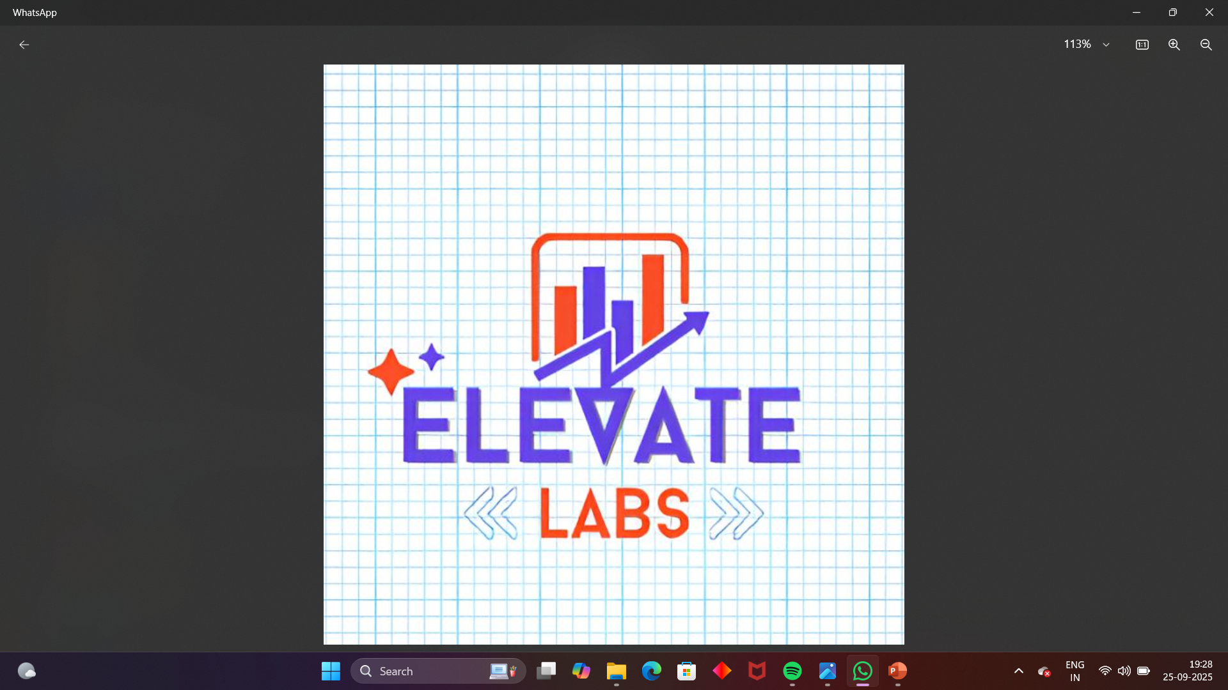
Sales Dashboard Report
#14 Data Analyst Interns
Created using Excel & Power BI

Slide 2
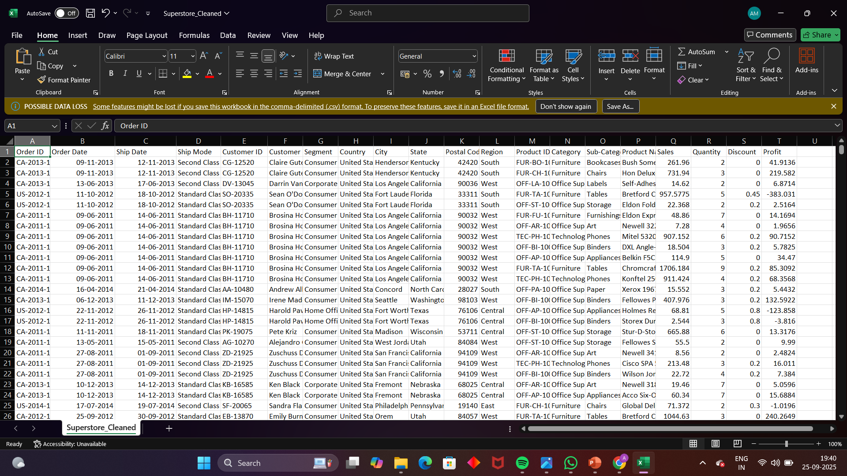
SUPERSTORE_CLEANED DATASET

Slide 3
Dataset Overview
• Dataset: Superstore_Cleaned.csv
• Contains sales, profit, quantity, and discount data
• Includes categories: Technology, Furniture, Office Supplies
• Segments: Consumer, Corporate, Home Office
• Time dimension: Monthly sales data

Slide 4
Dashboard Overview
The Power BI Dashboard provides key insights into:
• Total Sales: 2.30M
• Total Profit: 286.40K
• Total Quantity: 38K
• Total Discount: 1.56K
These KPIs help track overall business performance.

Slide 5
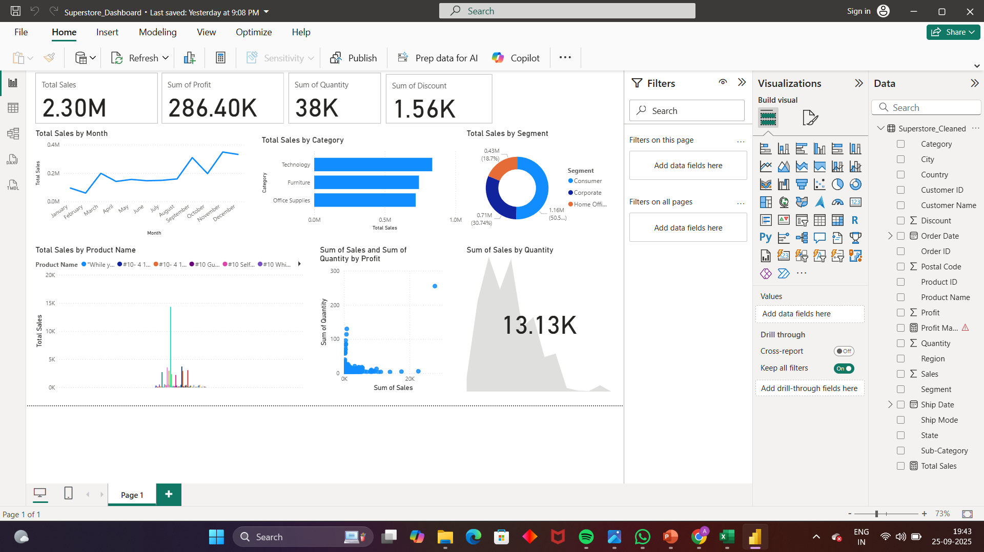
WORKING IN POWER BI

Slide 6
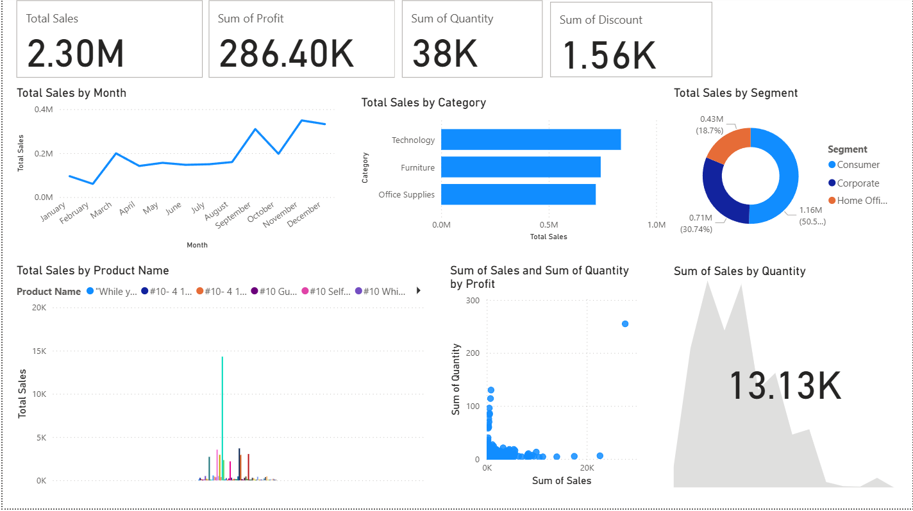
Dashboard Visuals

Slide 7
Key Insights
• Sales peaked in December with ~0.35M.
• Technology category has the highest sales (~1M).
• Consumer segment contributes ~50% of sales.
• Discounts remain minimal compared to sales.
• Most products have small contributions, with a few top performers.

